Slide 1
Module : Data Science & Machine Learning

Slide 2
Today’s Topics
Unsupervised Learning
Clustering
K means Clustering
Hierarchical Clustering
Curse Of Dimensionality
Dimensionality Reduction
PCA

Slide 3
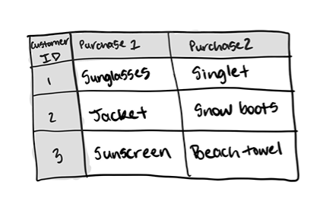
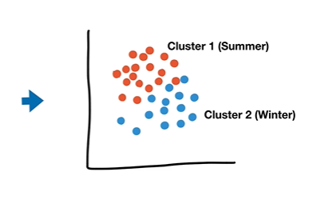
Unsupervised Learning
Recommending music based on past experience

Slide 4
Clustering
Grouping a set of data points such that the points in the same group are more similar to each other than those in other groups(clusters)
One of the methods for grouping unlabeled data
Very common technique used for statistical data analysis
Two mainly used clustering algorithms :-
--- K Means Clustering
--- Hierarchical Clustering

Slide 5
Applications of Clustering
Recommendation engines
Market segmentation
Social network analysis
Search result grouping
Medical imaging
Anomaly detection and more..!

Slide 6
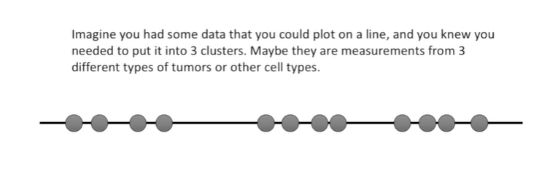
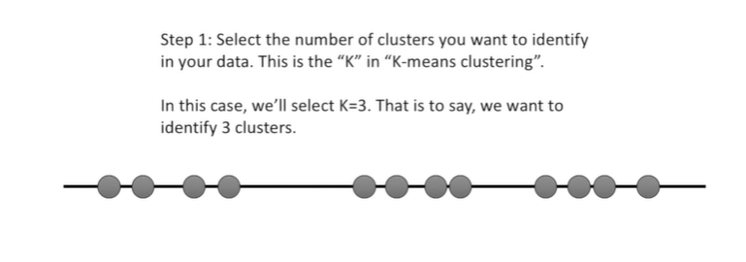
K-means Clustering
https://www.youtube.com/watch?v=4b5d3muPQmA&ab_channel=StatQuestwithJoshStarmer

Slide 7
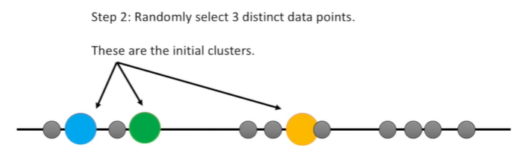
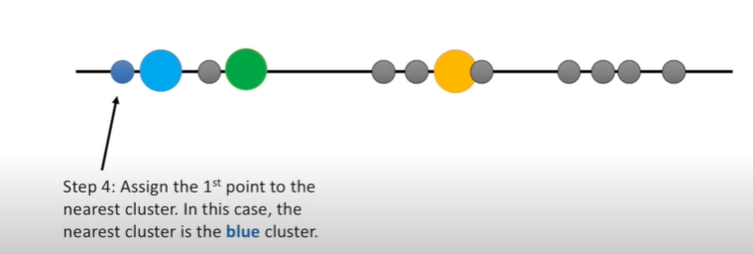
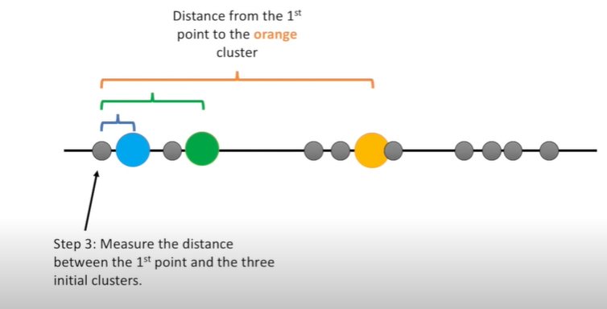

Slide 8
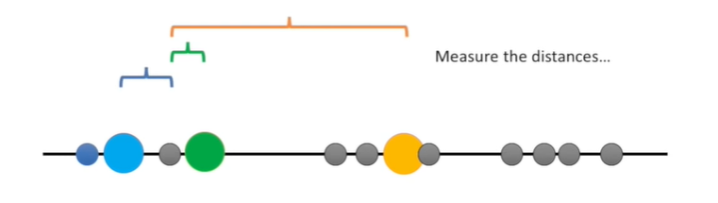
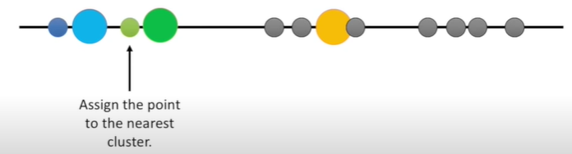
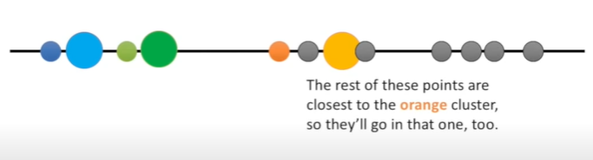
<< --- For the second point

Slide 9
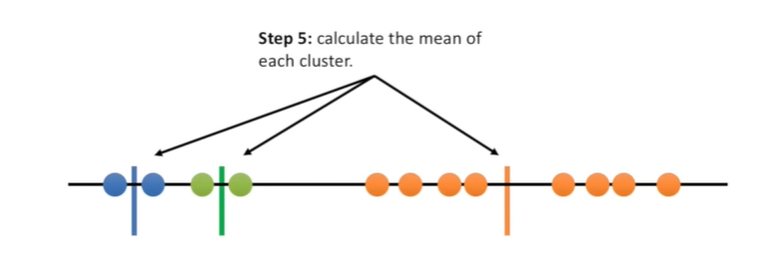
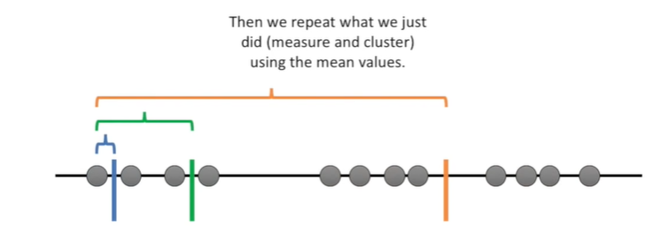
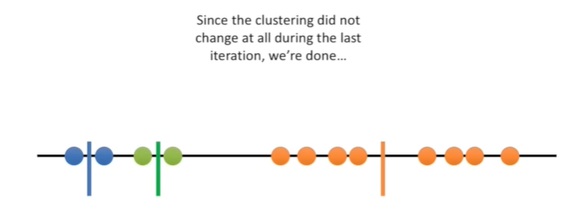

Slide 10
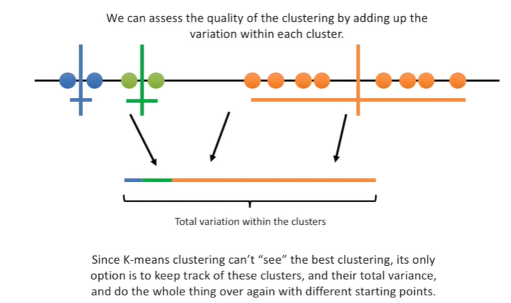

Slide 11
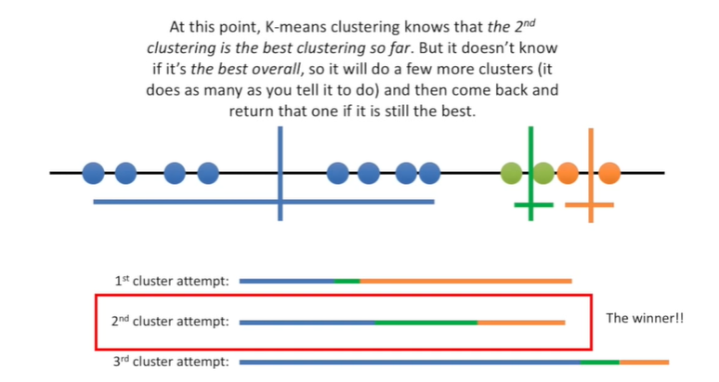

Slide 12
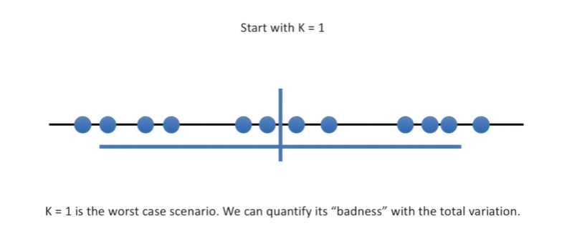
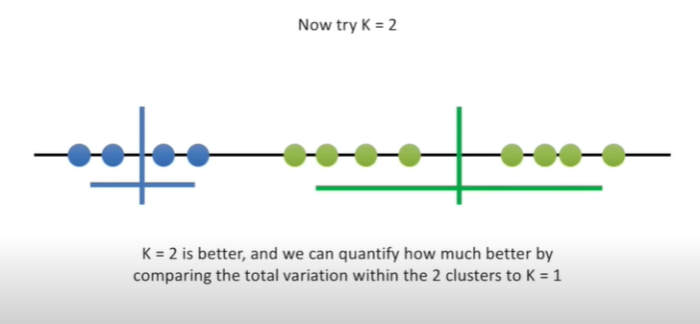

Slide 13
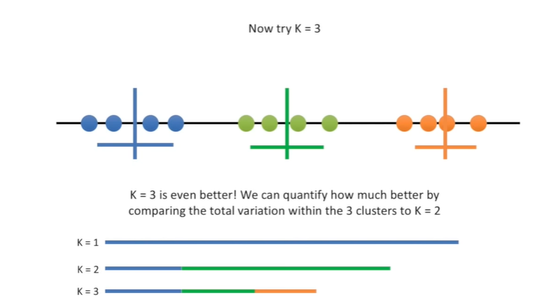
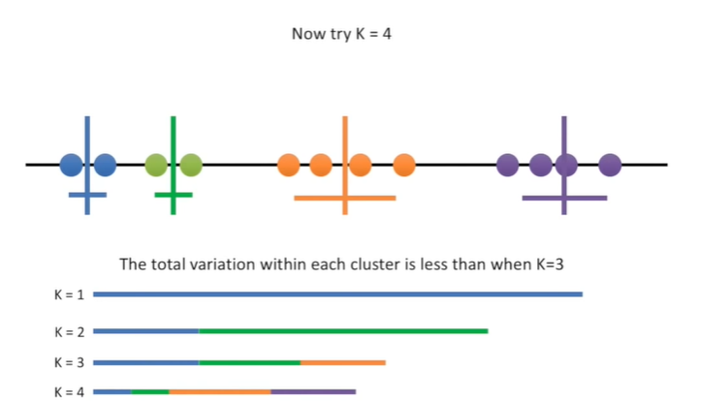

Slide 14
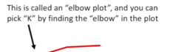
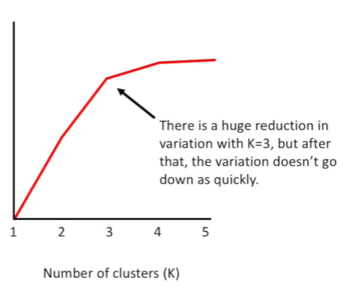
How do you figure out the perfect k value?
Reduction in Variation

Slide 15

Hierarchical Clustering

Slide 16
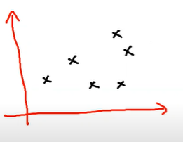
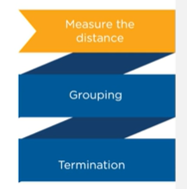
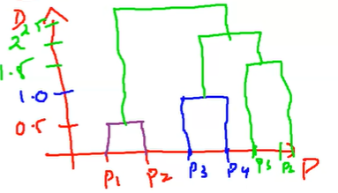
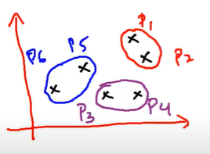
Hierarchical Clustering

Slide 17
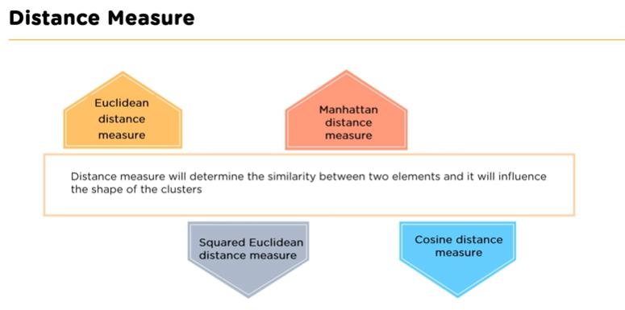
Hierarchical Clustering

Slide 18
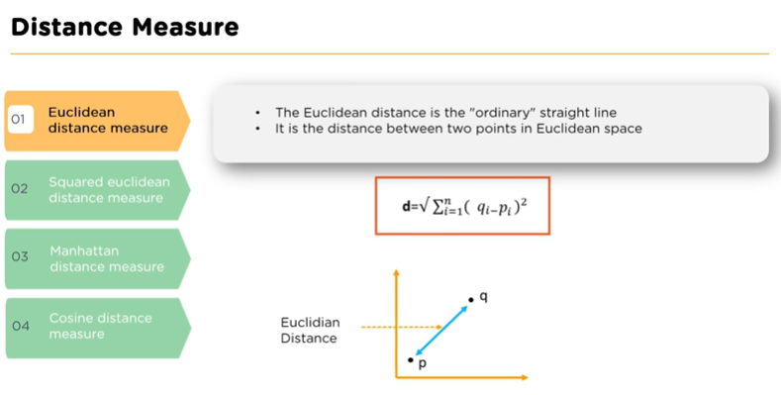

Slide 19
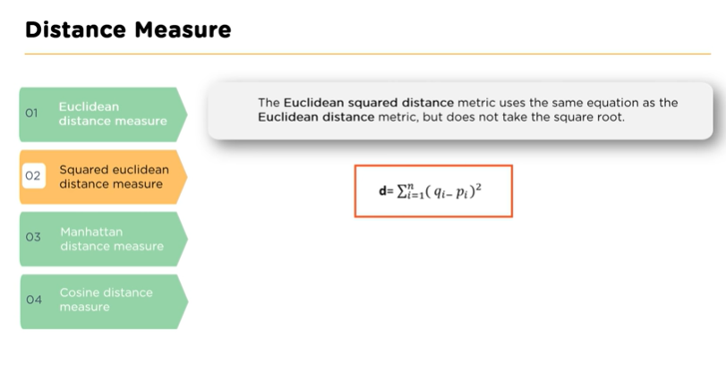

Slide 20
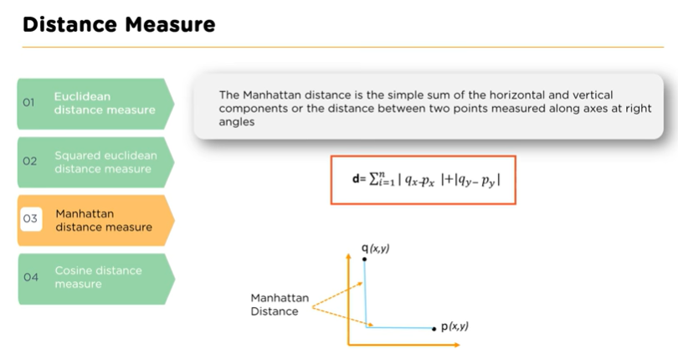

Slide 21
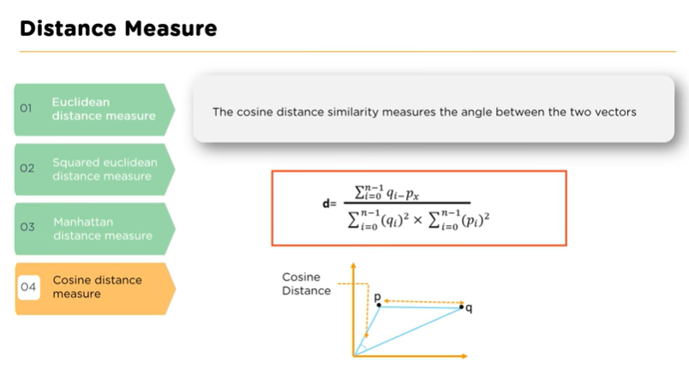

Slide 22
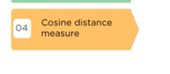
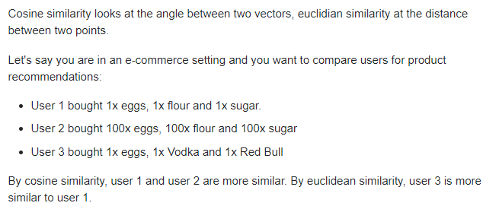

Slide 23
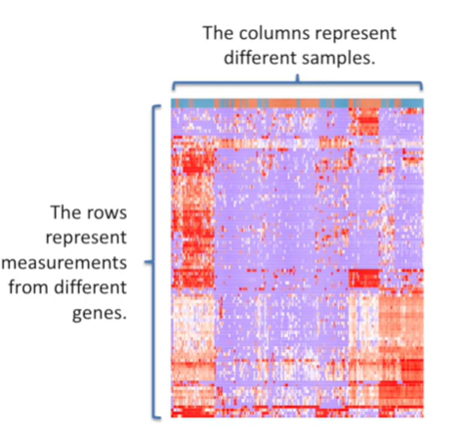
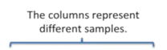
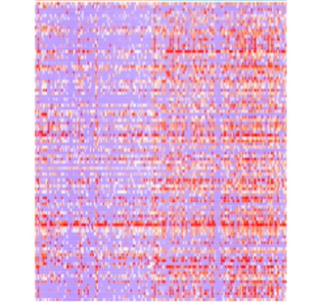
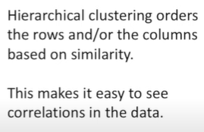
Hierarchical Clustering and Heatmaps
Without Clustering..!

Slide 24
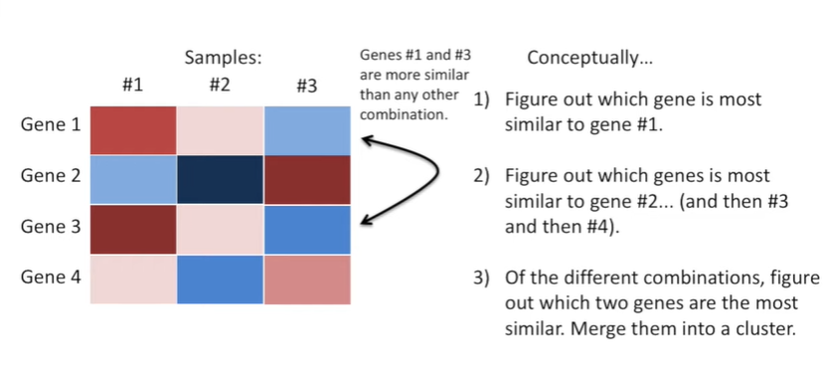
Hierarchical Clustering and Heatmaps

Slide 25
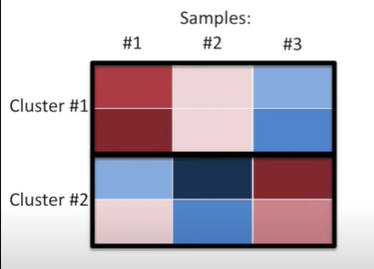
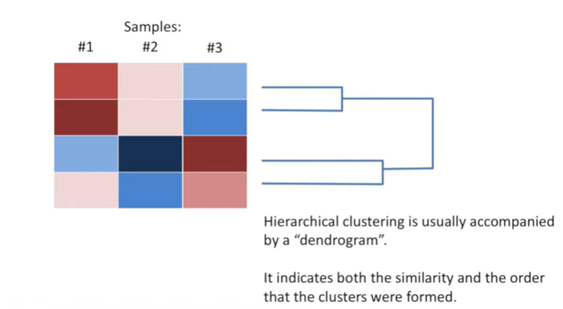
Hierarchical Clustering : Dendrogram

Slide 26
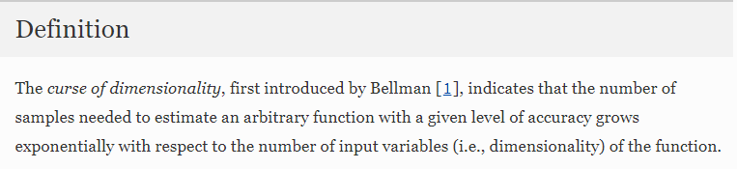
Curse of Dimensionality
What if you have 100 attributes/features with you?
The curse of dimensionality basically means that the error increases with the increase in the number of features.
https://link.springer.com/referenceworkentry/10.1007%2F978-0-387-39940-9_133

Slide 27
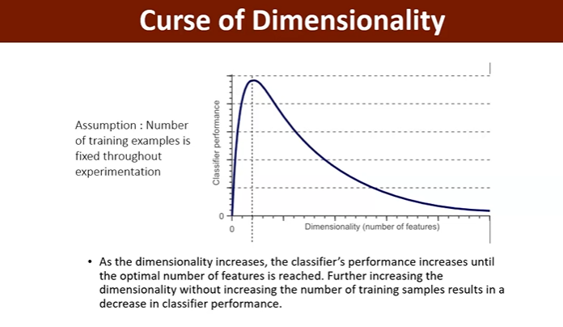

Slide 28
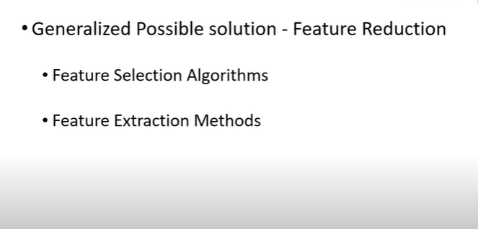
Solution – Dimensionality Reduction!

Slide 29
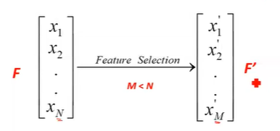
Feature Selection
Given an initial set of features
Find the subset of F
Take only relevant, meaningful features

Slide 30
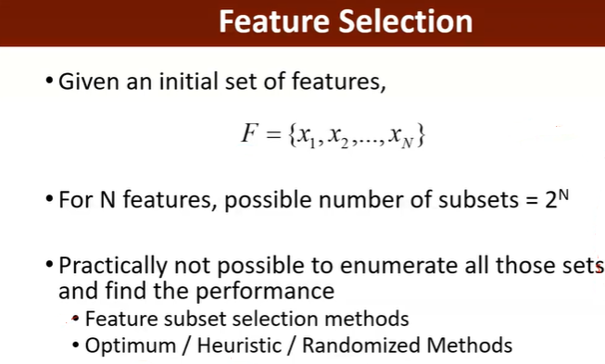

Slide 31
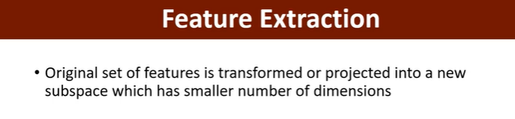
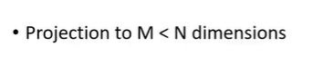
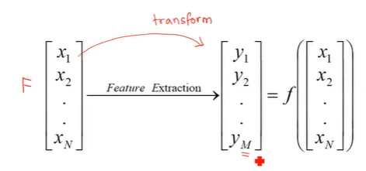

Slide 32
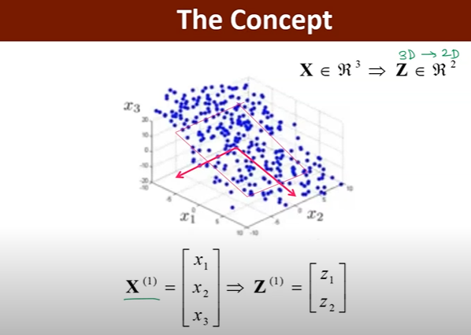

Slide 33
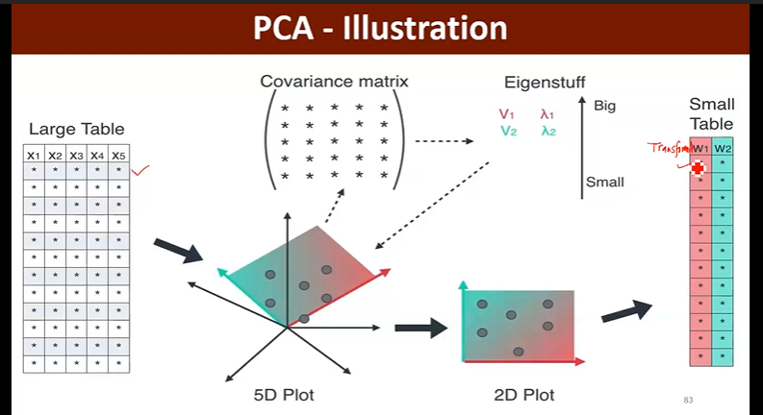
PCA

Slide 34
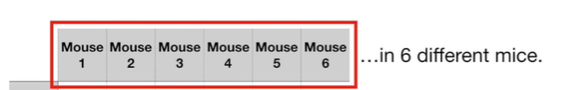

PCA - Example

Slide 35

1 - D

Slide 36

2 - D

Slide 37

3 - D

Slide 38

4 - D

Slide 39

4 - D

Slide 40


Slide 41
References
Clustering:
https://www.analyticsvidhya.com/blog/2016/11/an-introduction-to-clustering-and-different-methods-of-clustering/#:~:text=Clustering%20is%20the%20task%20of,and%20assign%20them%20into%20clusters.
https://towardsdatascience.com/the-5-clustering-algorithms-data-scientists-need-to-know-a36d136ef68
Hierarchical Clustering
https://www.displayr.com/what-is-hierarchical-clustering/#:~:text=Hierarchical%20clustering%2C%20also%20known%20as,broadly%20similar%20to%20each%20other.

Slide 42
Let’s Recap!
Clustering
K-means Clustering
Hierarchical Clustering
Curse of Dimensionality
Feature Selection
Feature Extraction
PCA

Slide 43
Thankyou ☺

